Slide 1
Welcome to NC CRRC

Slide 2
This Morning’s Plan
Talk about who we are
What will we do in this workshop
Breakout labs
Eat lunch

Slide 3
Who are Kyle & Cody

Slide 4
What we’ll cover: Session I
We’re all birds of a different feather
High level overview of what these tools are
Network taps
Protocol analysis (wireshark)
Summarize data (bro/zeek)
Alerting on bad stuff (snort/suricata)
Methods of capturing network traffic
What does our data look like: NSM centric
Deeper dive into wireshark
File extraction
Scavenger hunt

Slide 5
Session II
Linux Distros that package many of the tools you’ll need
Security Onion
More traffic analysis and NSM tools
Network Miner
Sguil
Elastic (Kibana)
Bro/Zeek

Slide 6
Session III: IDS Rules
Introduction to IDS
Detection methods
Signature
Anomaly
Writing Suricata Rules
Lots of practice/lab exercises!

Slide 7
Session IV: TLS Inspection
For those with more money than time
Dip into commercial firewall applications
Palo Alto
It’s ok: academics can get it for free
Application ID
Issues in capturing traffic: encryption
Methods of solving: encryption

Slide 8
Session V: Wireless
We hype packet level analysis
But we often forget… wifi
Key pieces of 802.11: management frames
Normal stuff: associations & disassociations
What trashy things do people do on 802.11?
How we can detect/monitor for this

Slide 9
Session VI
The last session!
Network monitoring scavenger hunt

Slide 10
Getting Traffic
Just use a hub
Port mirroring/SPAN port
Network TAP

Slide 11
Using Hubs
Just kidding…

Slide 12
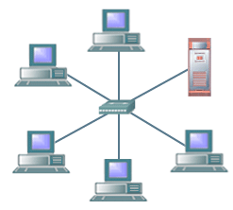
SPAN Ports
Mirror all traffic from a switch to a device
Device can be:
An analysis/capture device
A VLAN
A virtual machine
Can drop traffic if oversubscribed
“The switch treats SPAN data with a lower priority than regular port-to-port data” - Cisco

Slide 13
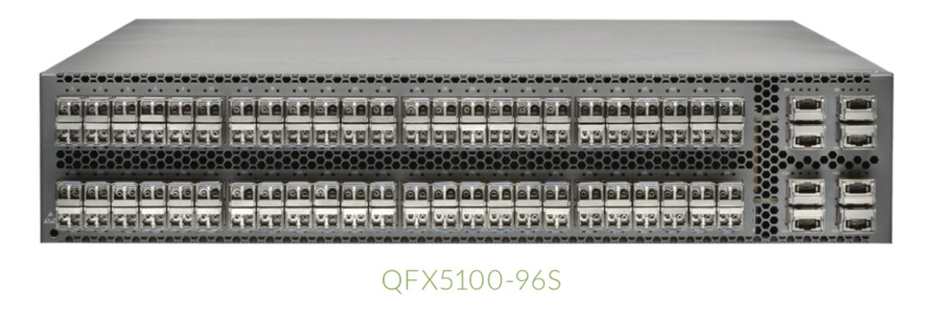
Oversubscription

Slide 14
Network TAP
TAP: Test Access Point
Can be active or passive
Meets extra legal requirements sometimes*
Isn’t hindered with oversubscriptions

Slide 15
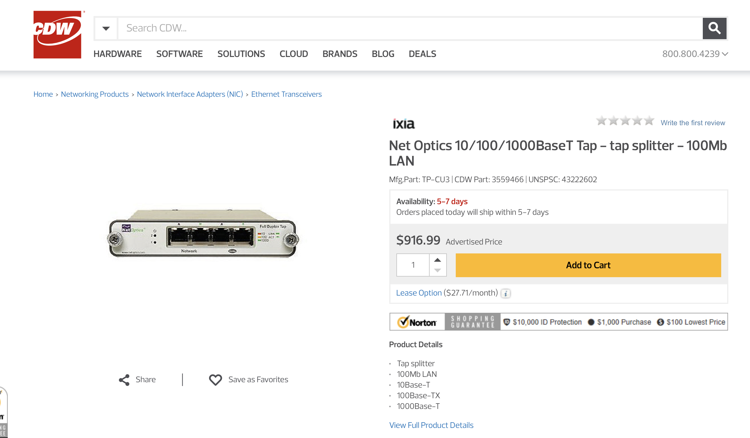

Slide 16
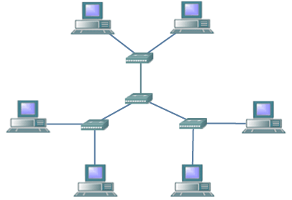
Challenges

Slide 17
Types of Data in NSM
There are many different types of data that can be collected
Full content
Extracted content
Session data
Transaction data
Statistical data
Metadata
Alert data

Slide 18
Full Content Data
All information that passes across the network sensor
No filtering
Not just malicious things
Typically, analysts will not work directly in full data all the time
They’ll pivot there from other information
Start analyzing full content data by inspecting the headers
Getting a summary view of the traffic
Then continue down to individual packets
Wireshark!

Slide 19
Extracted Content Data
High level data streams transferred between computers
Files
Images
No MAC addresses, IP addresses, protocols…
Just the actual things that are transferred
Web page
Malware
Automated file extraction and analysis
Sandboxed analysis
VirusTotal.
Bro Files

Slide 20
Session Data
A record of the conversation between two computers
Bro’s conn.log is really good at this
Who spoke, when, for how long, how much did they say
Not necessarily what they said
Timestamp
Source ip and port
Destination ip and port
Protocol
Bytes sent by source
Bytes sent by destination
…and more

Slide 21
Transaction data
Similar to session data
Focuses on the requests and replies
For example, Bro’s http.log
Specific GET requests
Corresponding responses
Not as detailed as full content data
Often detailed enough to give you the gist of what’s going on
The NSM tools will need to understand the applications
What does HTTP look like
What does DNS look like
…and so on

Slide 22
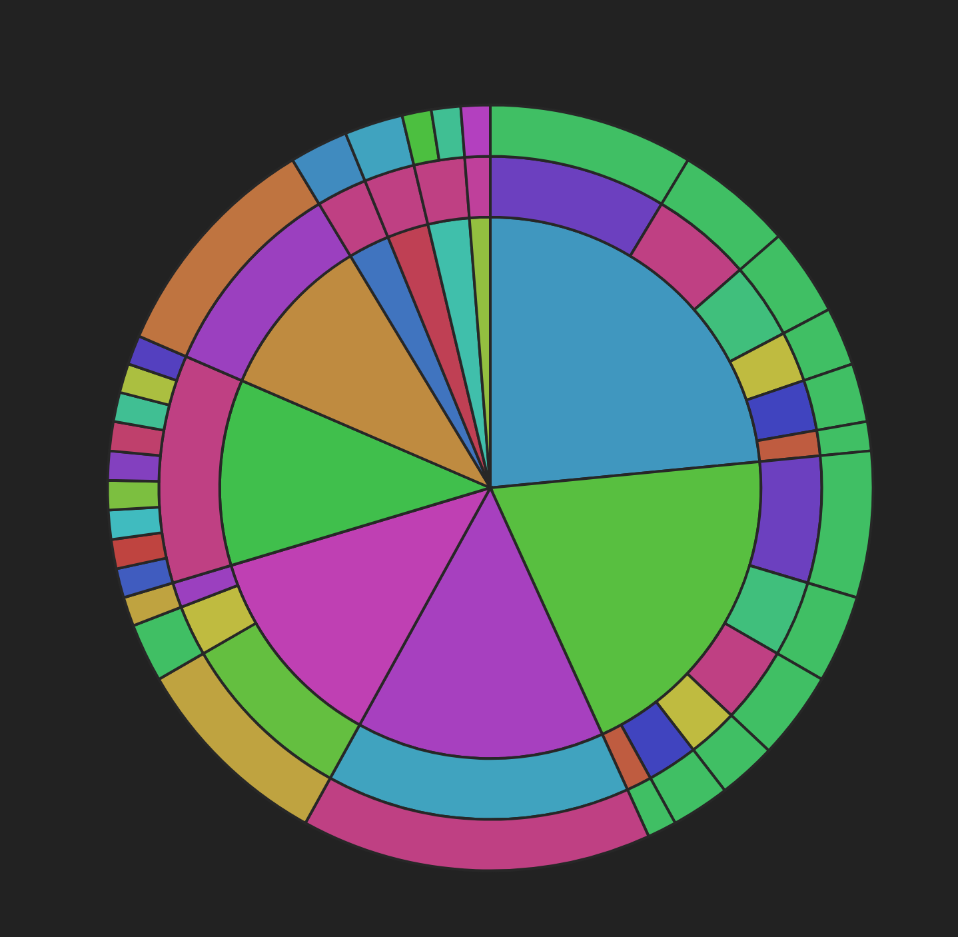
Statistical Data
High level information describing the traffic
Number of TCP packets
Number of UDP packets
Total size of a packet capture
Total number of logs
Graphs and visualizations
All default dashboards in Kibana have statistics of some sort

Slide 23
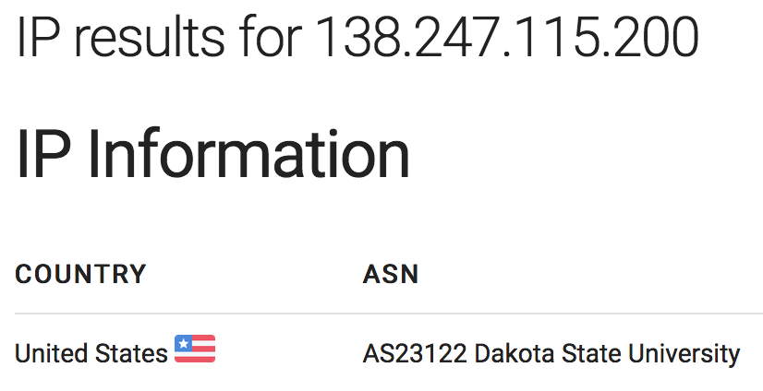
Metadata
Data about data
For example…
We see an IP address
Who owns that address? Do they pose a problem?
Query the whois database for an IP

Slide 24
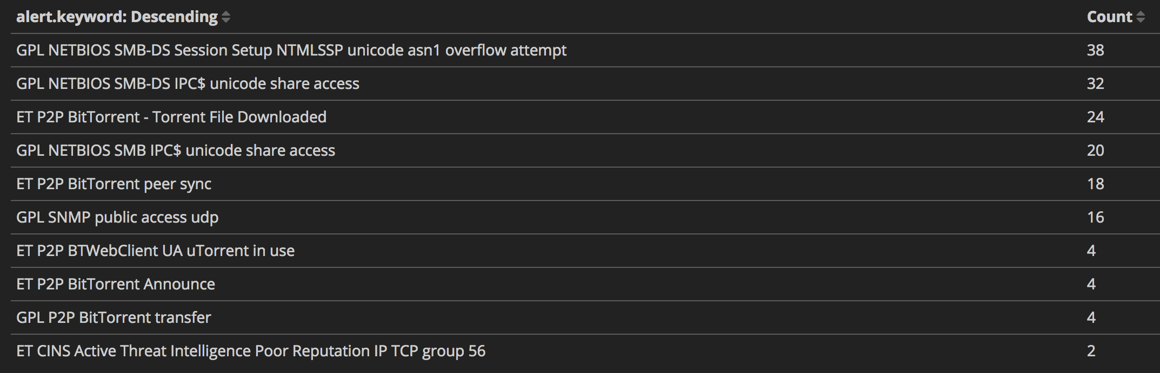
Alert Data
If traffic triggers an alert in an NSM tool
Like an IDS
Alerts based on patterns, counts of activity, or more complicated options

